Slide 1
PhD Research Update
David Faith Odesola

Slide 2
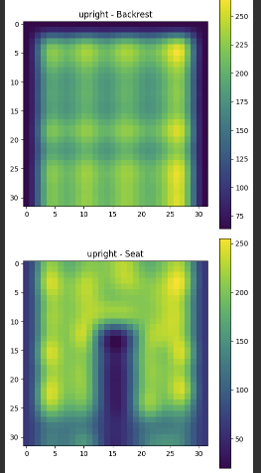
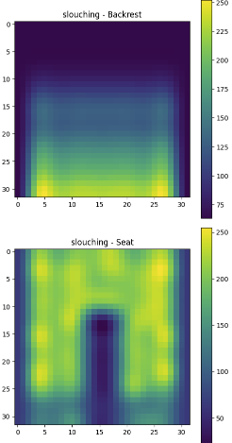
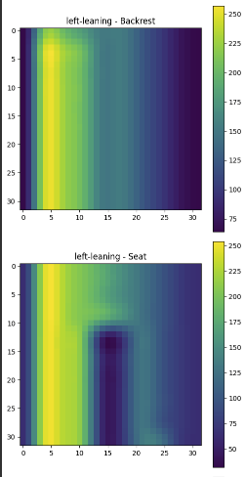
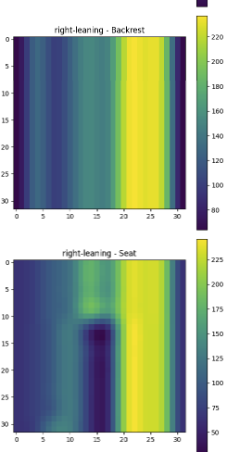
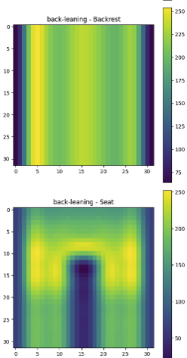
5 Base Postures
Upright
Slouching
Leaning Left
Leaning Right
Leaning Back

Slide 3
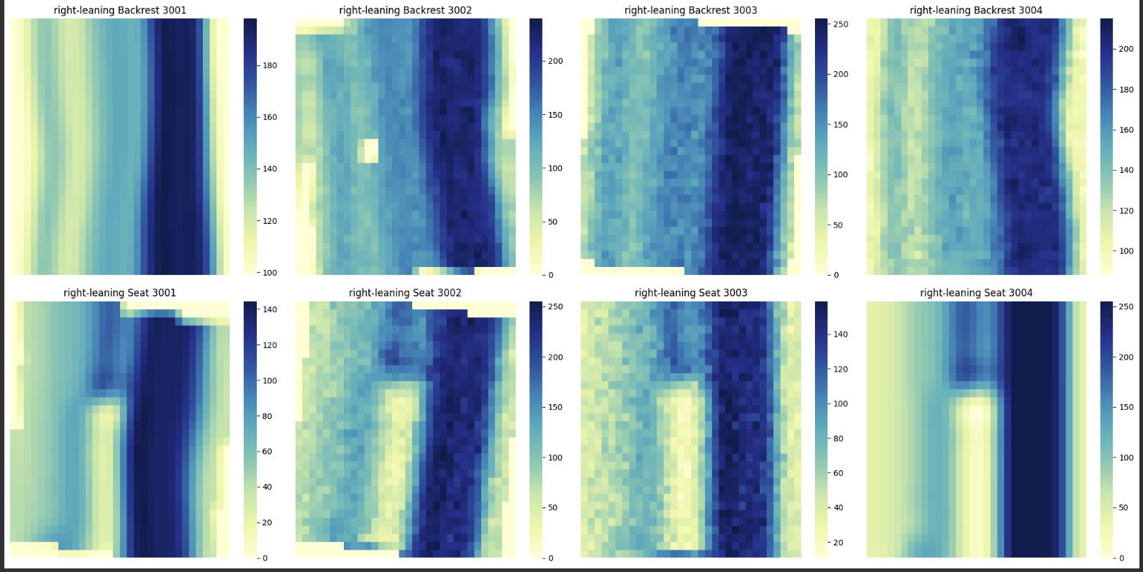
Data Augmentation
1000 samples/posture

Slide 4
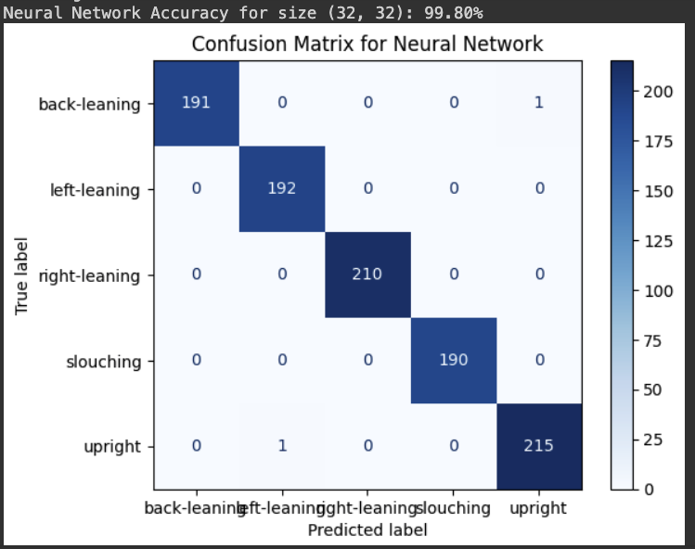
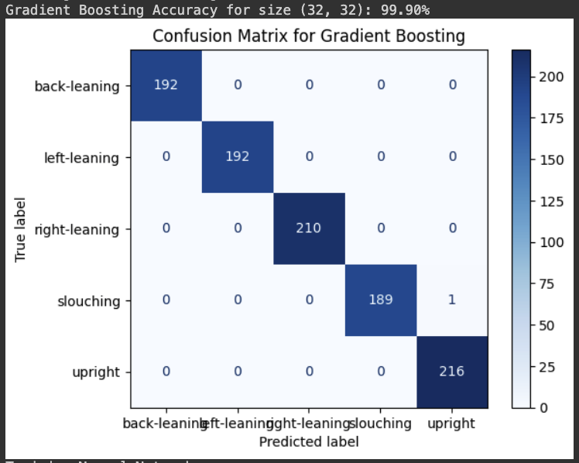
Model Performance

Slide 5
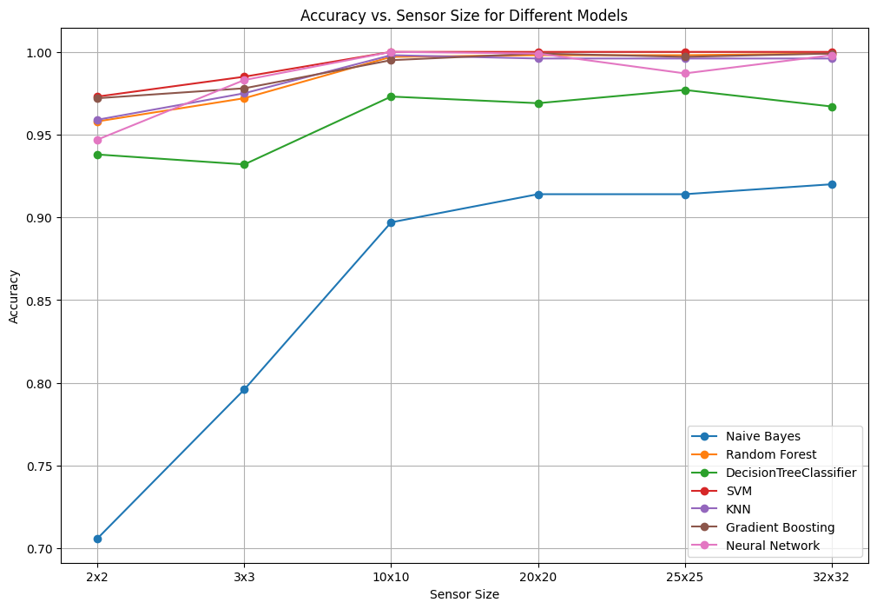

Slide 6
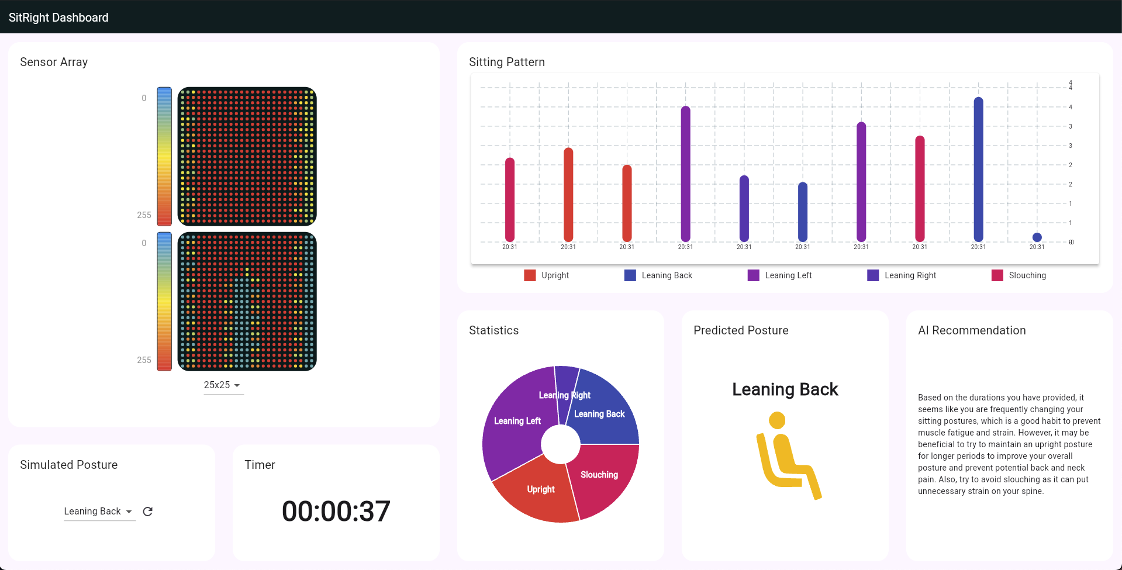
Simulator Tool

Slide 7
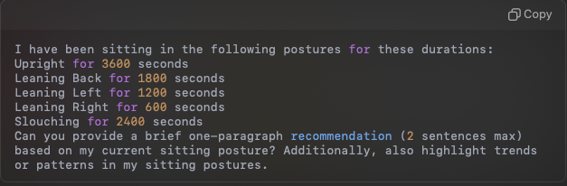
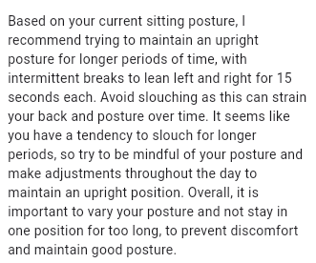
OpenAI Integration
Prompt:
Response:

Slide 8
Todo
Questions
Sensor Integration
Mobile App development
How many sensors are required to accurately classify different sitting postures?
How do we strategically decide the placement of each sensors?
How do we make the recommendation more personalised and relevant?

